Slide 1
Citizens Bank InSource of Appworks Education Finance and Personal Lending Data
Updated: January 26, 2021

Slide 2
Agenda
Appworks Background
Current & Future Responsibilities
Phase Definitions
Phase 0: Prerequisites
Phase 1: Options & Analysis
Phase 2: Execute Option
Phase 3: Decommission Sungard
Current Application Documentation
High Level Application Blocks
Student/PERL Conceptual Design
Collocation Physical Diagram
Dated diagram 2017
Project & BAU Workflow
Tech Team Stakeholders
Next Steps
Appendices

Slide 3
Appworks Background
Entech provides a number of applications/services for Citizens that as a whole are commonly referenced as “Appworks”
Student Lending – AOL
Personal (PERL) Lending – AOL
Lender Web
Branch/Phone App
School Certification
Rate Quote Calculator
Product Works
Micro Works - Microsite management (~100 of microsites), lending marketing management
HELOC landing page
Document Management (Operational Service)
Appworks History
Pre 2013
VTEK was original builder and owner of all system/equipment.
2013
VTEK went out of business in 2013 and All1Team took over Appworks development and support in March 2013
2015
Entech signed Assignment & Assumption of Agreements in Aug 2015
2020
Entech legally changed its name to Anovaa
Appworks
Single instance supports 2 both PERL and Student
Appworks Software is built, maintained and supported by Anovaa
Responsive web design, web services, Oracle Single Node DB, SQL DB
Jenkins, Crucible, Jira, Git
Selenium for automated testing @Entech
SunGard datacenters
Prod @ Rancho Cordova, CA ; DR/UAT @ Scottsdale, AR
Citizens owns all hardware, and owns partial right to the software
Infrastructure is maintained by Entech
Base technology stack: .net frameworks, Visual Studio, SOAP, ORACLE, SQL Server, 3rd party libraries/controls (Metadefender)
Current platform
Frequent production and support issues
Multiple identified open risk items
Lack of desired business functionality
Lack of vendor agility to respond to velocity of change requests
Notes:
Performance. Inherently slow…
specifically the work queue for processors / underwriters

Slide 4
Current & Future Responsibilities
Current Responsibilities
Area | Business | Anovaa | TS | 3rd Party (ParkPlace)
Business Analysis | X | X
Requirements | X
Software Development |  | X
Build and Deployment |  | X
Integration Testing |  | X
QA Testing | X
Project Management | X
Change Mgmt | X | X | X
Risk action items | X | X | X
Incident Management | X | X | X
Infra Support |  | X | X (consultancy) | X
Future Responsibilities
Area | Business | Anovaa | TS | 3rd Party (ParkPlace)
Business Analysis | X |  | X
Requirements | X
Software Development |  |  | X
Build and Deployment |  |  | X
Integration Testing |  |  | X
QA Testing | X
Project Management | X |  | X
Change Mgmt | X |  | X
Risk action items | X |  | X
Incident Management | X |  | X
Infra Support |  |  | X
Notes:
Performance. Inherently slow…
specifically the work queue for processors / underwriters

Slide 5
Phase Definitions
Phase 0 ~ Prerequisites
Scope: Encompasses all the necessary groundwork required to enter into Phase 1 such as Anovaa
Alignment, Resources, Project/POD Formation.
Target Timeline: 4 – 6 Weeks
Phase 1 ~ Options & Analysis
Scope: Analysis to determine best option for Citizens Bank to assume support for Appworks
from Anovaa in order to support business requirements to retrieve documents and data
for audit, regulatory and asset sale inquires
Target Timeline: 8 – 12 Weeks
Options Under Consideration
Migration of Data + Creation of Basic Queryable Interface (AWS/On Prem)
Lift & Shift of Underwriting Application(?) & Data to AWS/CFG On Prem
CFG Support of Appworks as-is at Sungard
Other: Hybrid
Feature Prioritization & Sequencing
Phase 2 ~ Execute Option
Scope: Execute Selected Option from Phase 1
Target Timeline: 3 – 6 Months based assuming Option 1 Selected
Phase 3 ~ Decommission of Sungard
Scope: Decommission of Sungard Hardware
Target Timeline: 6- 8 Weeks
Notes:
Performance. Inherently slow…
specifically the work queue for processors / underwriters

Slide 6
Phase 0: Prerequisites
Anovaa Alignment
IP Ownership Resolution w/Agreement for Citizens to Access Source Code
Transition Agreement to include Anovaa and possibly Sungard
Roles/Responsibilities
Vendor SOW Expectations
Initiative
Scope Definition (Business Needs Assessment)
High Level Definition
Bring data/documents in-house
R/O Queryable Interface to Data
Ingest any loans with disbursements in 2022 into LaaS
Any multi-year loan with an open credit converted into LaaS
Funding source via Planview
Team Formation
Establish initial assessment team
CB Tech Lead (completed – Eric)
Secure former Entech SME’s as a consultant (complete – Sivarm)
TS Resource Roles Identified
Scrum Master (Vishal to obtain)
Cloud/Application Architect (Vishal to obtain)
Domain Analyst (Eric to obtain or push to Vishal)
EDM/EDS
Data Modeler (Eric to obtain)
DBA (Eric to obtain)
Senior Software Engineers
Senior Full stack Lead Engineer (Vishal to obtain)
Senior Engineer (Swami)
Network Engineers
Create JIRA Board
Create Epics
Establish Standup
Notes:
Performance. Inherently slow…
specifically the work queue for processors / underwriters

Slide 7
Phase 1: Options & Analysis
In order to select the best option to support the business needs TS will need to complete an Options & Analysis which will include an application assessment.
Target Date:
March 2021 latest; Optimal February 2021
Options Under Consideration
Migration of Data + Creation of Basic Queryable Interface (AWS/On Prem)
Lift & Shift of Lender Web Application & Data to AWS/CFG On Prem
CFG Support of Appworks as-is at Sungard
Other: Hybrid
Critical Success Factors
Timely Response times and accessibly to Anovaa SMEs
Ability to access required information only
Quickly spin up a dedicated POD
Limitations
Feature Freeze
Access only to data via the “Underwriting” application. No support for rate quotes, 3rd party interface, application processing, originations, servicing, etc
Risks
Limited number of Anovaa SMEs
Appworks is a legacy system with inherent problems which Anovaa has had issues supporting
All infrastructure is not based on CFG images nor standards
Citizens currently has no expertise to support:
Barracuda Load Balancers
VEEAM Backup Software
Underwriting website has never been scanned for Top 10 OWASP vulnerabilities
1 Systematic Configuration Discovery if possible
Notes:
Performance. Inherently slow…
specifically the work queue for processors / underwriters

Slide 8
Phase 1: Options & Analysis
Application Assessment
Data
Define Data Sources & DB Versions
Obtain ERDs
Determine source locations for document retrieval
Application
Primary Functional Areas
Technology Stack
.net frameworks, VS Version, 3rd party libraries/controls, etc
Security
Encryption
Methods for document retrieval
Deployment Tiers
Server OS Versions
IIS Settings
Systematic Configuration Discovery¹ if possible
Output
System Documentation from Vendor*
Source Code from Vendor* (Application, DB, system configurations)
Current System Architecture and Topology
Infrastructure / Network Diagrams
1 Systematic Configuration Discovery if possible
Notes:
Performance. Inherently slow…
specifically the work queue for processors / underwriters

Slide 9
Phase 2: Execute Option
Phase 2 will implement the option recommended from Phase 1.
Target Date:
December 2021 latest; Optimal September 2021
Critical Success Factors
Operational solution before end of Anovaa support agreement
Solution Architecture
Agile Solution Execution
To include incremental roll out of solution
Notes:
Performance. Inherently slow…
specifically the work queue for processors / underwriters

Slide 10
Phase 3: Decommission Sungard
This phase will implement the option recommended in Phase 1.
Target Date:
December 2021 latest; Optimal September 2021
Critical Success Factors
Archival of old AppWorks code/schema/data
Decomission of AppWorks
Disposal of hardware
Notes:
Performance. Inherently slow…
specifically the work queue for processors / underwriters

Slide 11
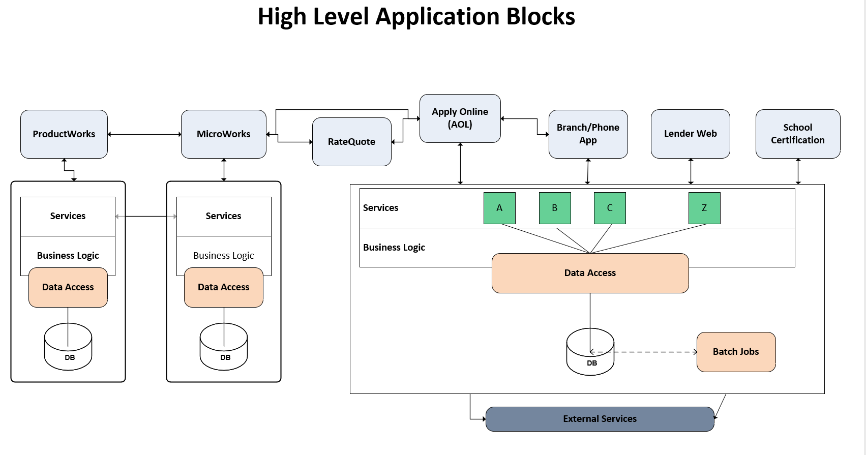
Current Application Documentation
Link: HighLevelApplicationBlocks (citizensbank.com)
Notes:
Performance. Inherently slow…
specifically the work queue for processors / underwriters

Slide 12
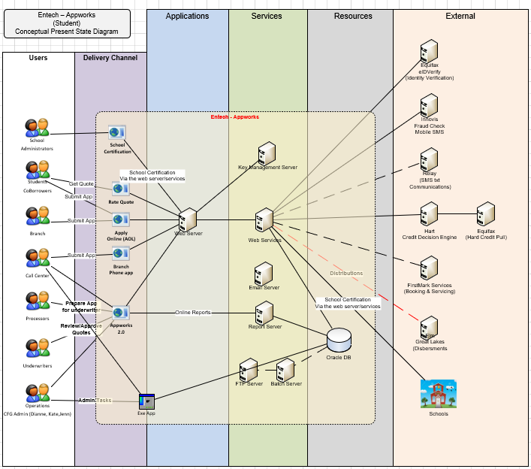
Current Application Documentation
Student/PERL Conceptual Design
Link: Entech_Assesment (citizensbank.com)
Notes:
Performance. Inherently slow…
specifically the work queue for processors / underwriters

Slide 13
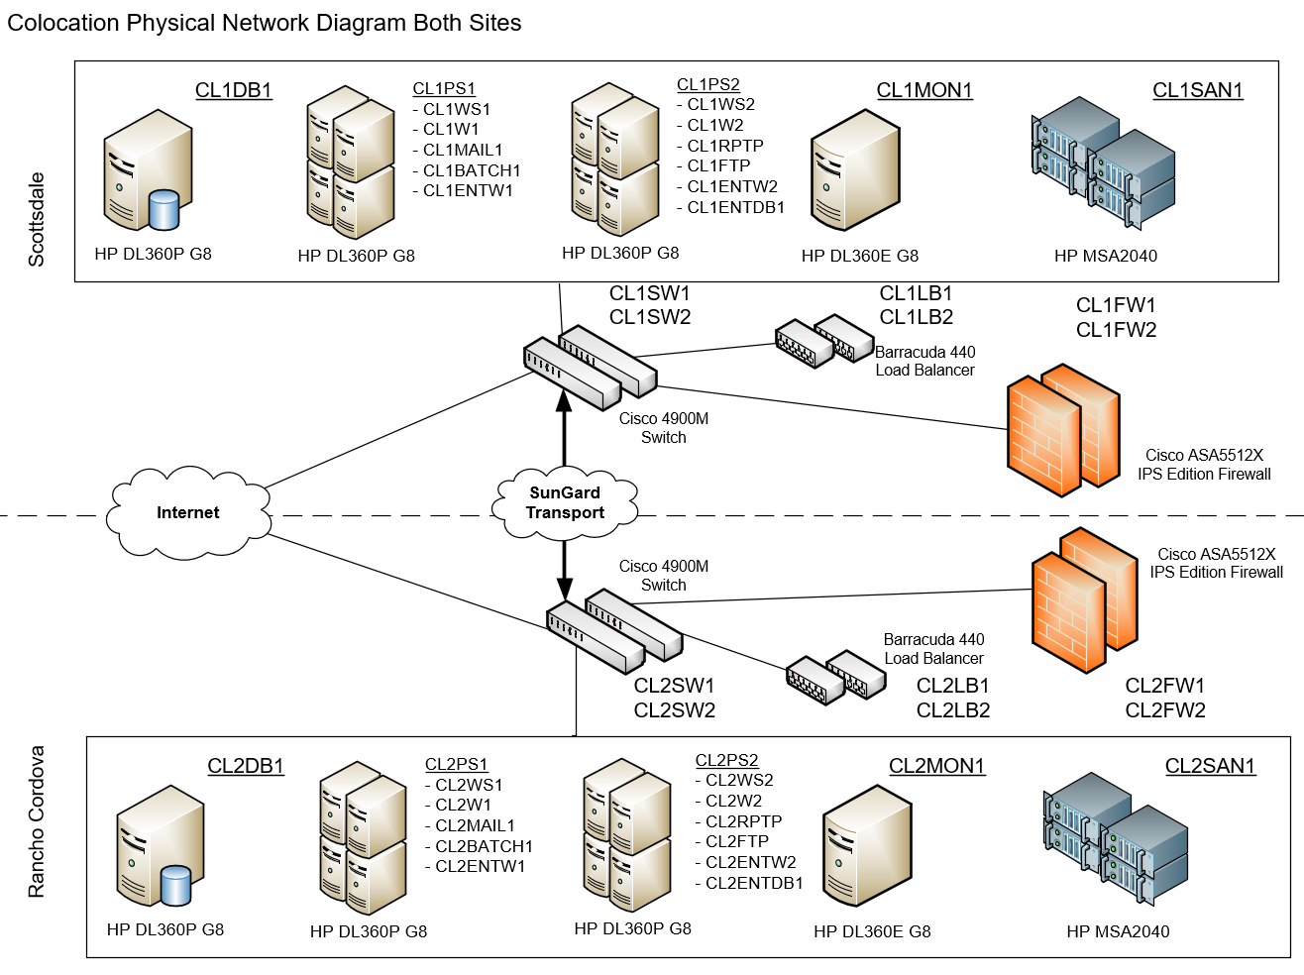
Current Application Documentation
* Dated 2017
Link: Physical Network Diagram (citizensbank.com)
Notes:
Performance. Inherently slow…
specifically the work queue for processors / underwriters

Slide 14
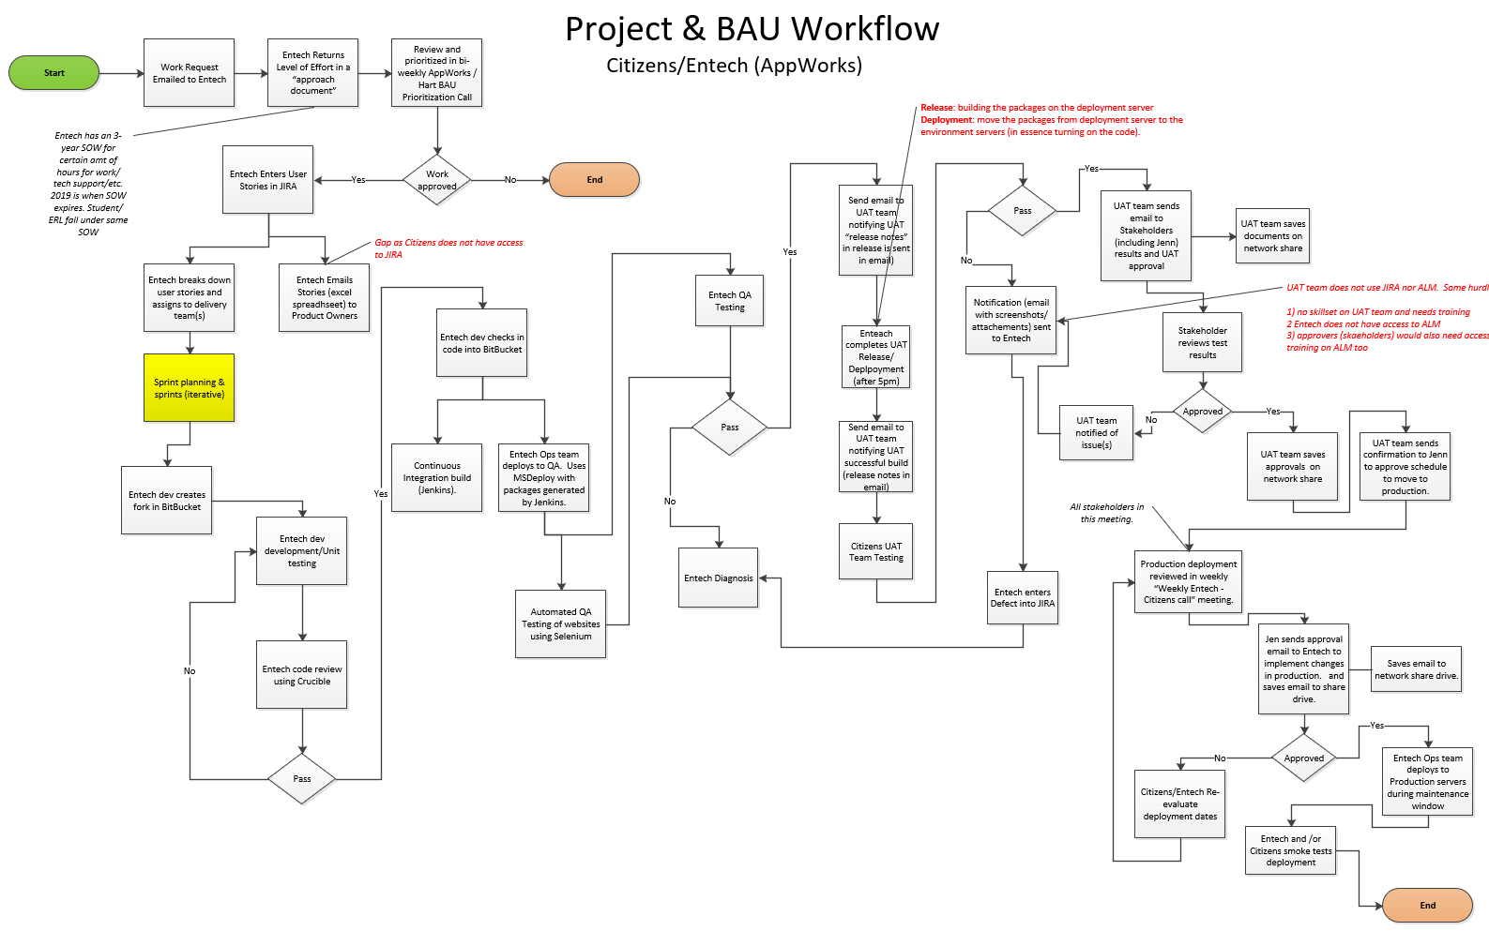
Current Application Documentation
Link: EntechProjectWorkFlow (citizensbank.com)
Notes:
Performance. Inherently slow…
specifically the work queue for processors / underwriters

Slide 15
Tech Team Stakeholders
Support: Jeff Brock
Wintel: Jon Dixon
Network: Steve White
Storage: Chino Rao
EDS Architecture: Jim Gregg
EDS: Karen Miglietta
IAM: Ginny Palmer/Kevin Schwab
DRET : Bob Stebbins/Matthew Russell
Cyber: Matt Darlage
IAM: Ginny Palmer/Kevin Schwab
DRET : Bob Stebbins/Matthew Russell
Cyber: TBD
EDS Architecture: Jim Gregg
Exchange: TBD
Unix: TBD
Barracuda Load Balancer: TBD
Compliance/Risk: TBD
Sungard: TBD
Notes:
Performance. Inherently slow…
specifically the work queue for processors / underwriters

Slide 16
NEXT STEPS
Enter Phase 0
Notes:
Performance. Inherently slow…
specifically the work queue for processors / underwriters

Slide 17
Appendices: Migration
Migration Execution Architectural Review Board
Initial Setup / Prep
DNS
Port Opening
Active Directory (Admin and RDP)
Identity and Access Management / Security Groups
Code Repository (BitBucket)
CI/CD (Application Deployment Pipeline to include Infrastructure as Code )
Disaster Recovery Strategy
Data Migration Strategy
Application Load Balancing
SSL Certificate Definition (Venafi)
Key Management (KMS)
Notes:
Performance. Inherently slow…
specifically the work queue for processors / underwriters

Slide 18
Appendices: Migration
Migration Execution Architectural Review Board
Initial Setup / Prep
DNS
Port Opening
Active Directory (AdmMigration Execution continued
P-2 Deployment
Deployment via IAC and CI/CD
Testing (Infra, Security, Performance, Functional)
P-1 Deployment
Deployment via IAC and CI/CD
Testing (Infra, Security, Performance, Functional)
Change Advisory Board
Production Deployment
Deployment via IAC and CI/CD
Data Migration
Testing (Infra, Security, Performance, Functional, Parallel?)
Decommission of old Sungard solution
in and RDP)
Identity and Access Management / Security Groups
Code Repository (BitBucket)
CI/CD (Application Deployment Pipeline to include Infrastructure as Code )
Disaster Recovery Strategy
Data Migration Strategy
Application Load Balancing
SSL Certificate Definition (Venafi)
Key Management (KMS)
Notes:
Performance. Inherently slow…
specifically the work queue for processors / underwriters

